Slide 1
Library Management System
Project for MPP course
September 2024
Group No. 2
Marwane Bidamou
Temuulen Khuchit
Maria Luisa Lamprea

Slide 2
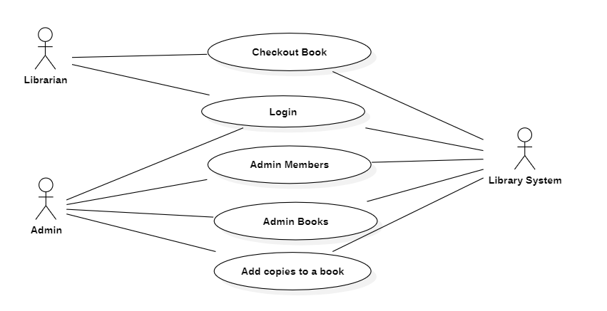
Use Case Diagram

Slide 3
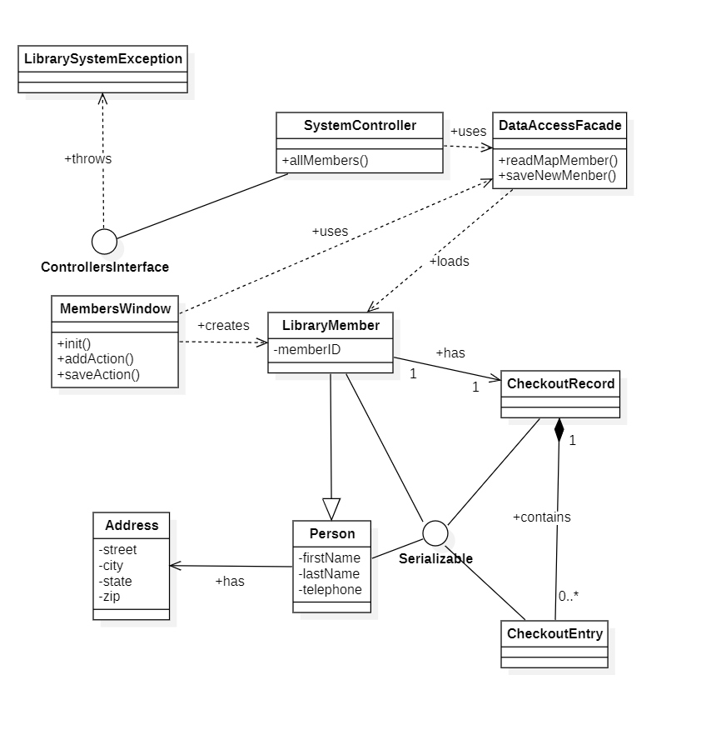
Class Model for add new Library Member use case

Slide 4
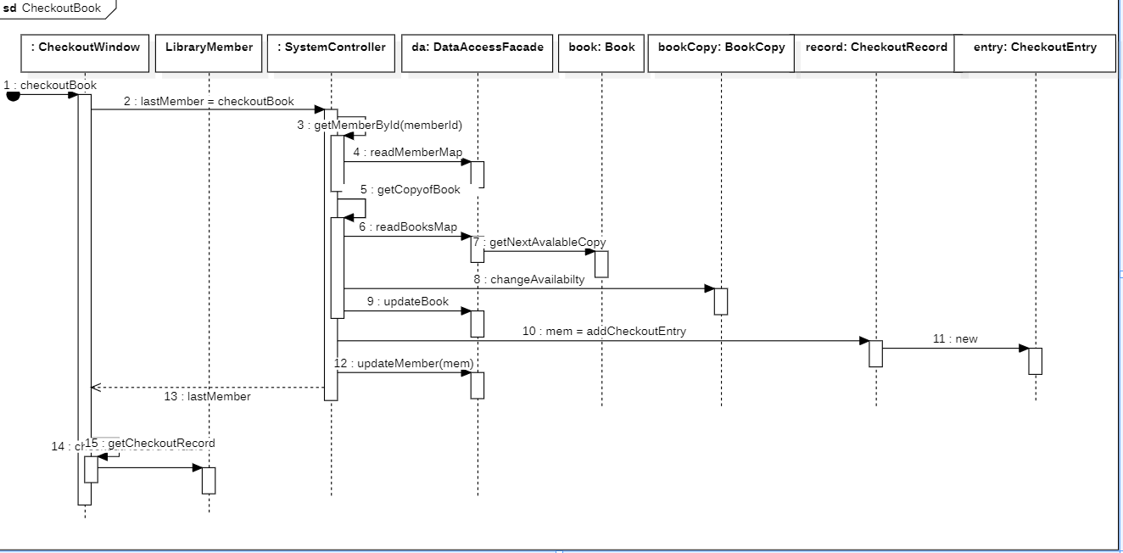
Sequence diagram for Checkout Book use case

Slide 5
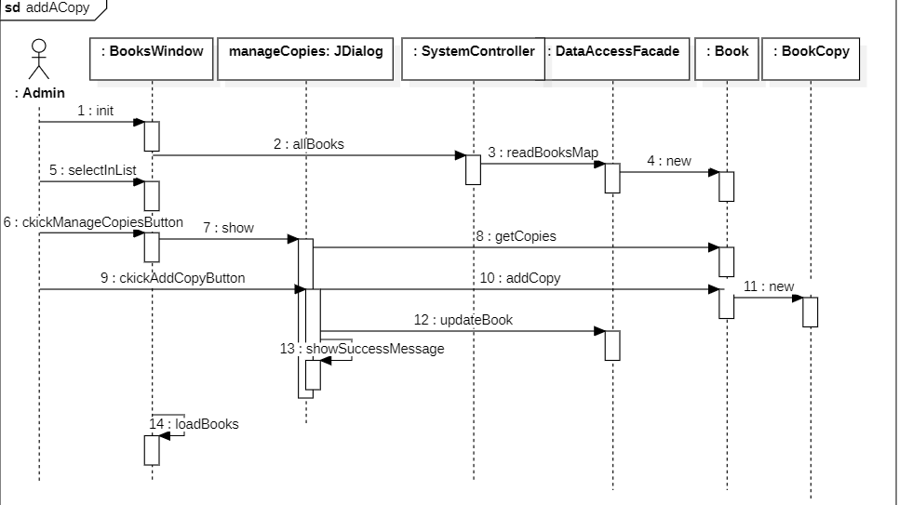
Sequence diagram for Add a Copy use case

Slide 6
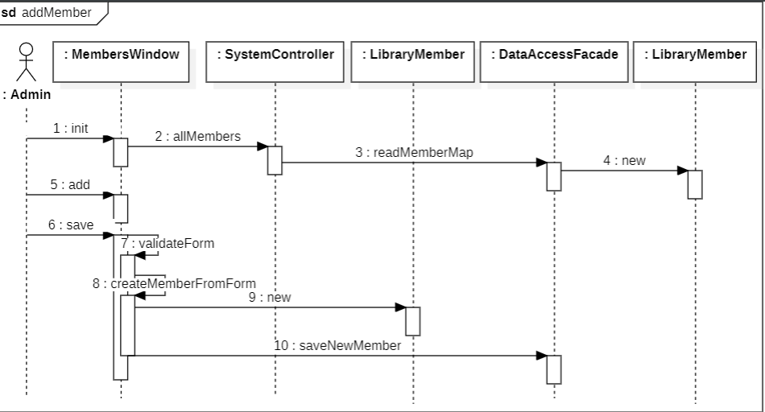
Sequence diagram for add a new Member use case

Slide 7
Discussion on Validation Rules of UI Windows
Many sources of validation that we’ve done: uniqness, mandatory, numberformat for pone number and ISBN

Slide 8
Conclusion with STC Knowledge
This is the way that STC’s principles are related with Modern programming practices:
Inner is the bases of the outer: A well-defined object-oriented design begins by modeling the business from inside by identifying its main objects and their properties, before using them in in concrete and visible programs.
Rest and Activity are the steps of progress: the best way to achieve goals as a team is to define proper times to work, rest and personal things.
Harmony exists in diversity: in a group of three people from different continents, diversity shows three different ways of seeing the same problem, but harmony makes the final product achieves all the expectations.
The field of all possibilities is the source of all the solutions: There are many ways of solving the same problem; so, don’t be afraid of trying one new

Slide 9

Git Hub reference
https://github.com/devmarwane/library-management

